Slide 1
Muhammed Tawfiq Chowdhury Data Structure Section 1 and 2 Queue

Slide 2
What is a queue in Java?
A queue is an interface in java
The interface Queue is available in the java.util package and does extend the Collection interface. It is used to keep the elements that are processed in the First In First Out (FIFO) manner. It is an ordered list of objects, where insertion of elements occurs at the end of the list, and removal of elements occur at the beginning of the list.
Being an interface, the queue requires, for the declaration, a concrete class, and the most common classes are the LinkedList and PriorityQueue in Java. Implementations done by these classes are not thread safe. If it is required to have a thread safe implementation, PriorityBlockingQueue is an available option.

Slide 3
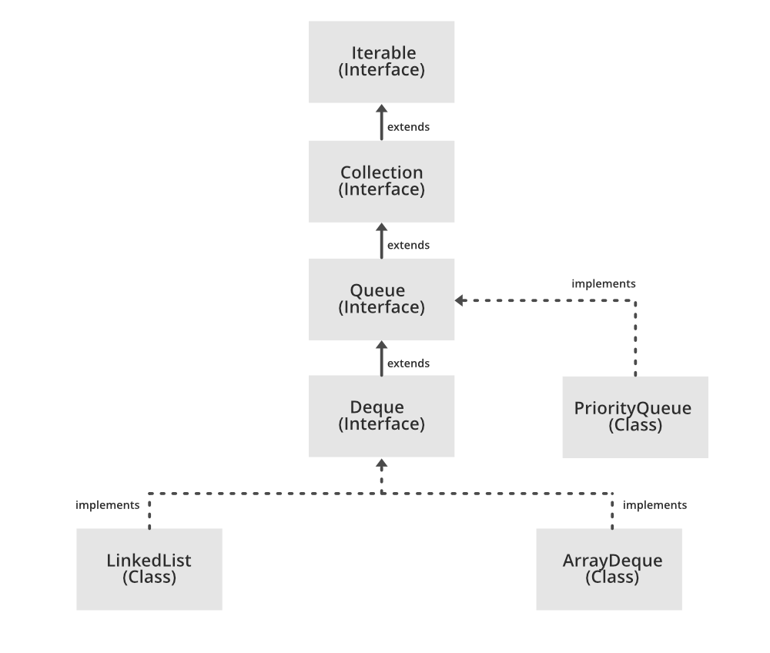
Structure of Queue

Slide 4
Characteristics of a Queue
The Queue is used to insert elements at the end of the queue and removes from the beginning of the queue. It follows FIFO concept.
The Java Queue supports all methods of Collection interface including insertion, deletion, etc.
The Queues which are available in java.util package are Unbounded Queues.
The Queues which are available in java.util.concurrent package are the Bounded Queues.
All Queues except the Deques supports insertion and removal at the tail and head of the queue respectively. The Deques support element insertion and removal at both ends.

Slide 5
Methods of Java Queue Interface
boolean add(object)-It is used to insert the specified element into this queue and return true upon success
boolean offer(object)-It is used to insert the specified element into this queue
Object remove()-It is used to retrieves and removes the head of this queue
Object element()-It is used to retrieves, but does not remove, the head of this queue.
Object peek()-It is used to retrieves, but does not remove, the head of this queue, or returns null if this queue is empty.
E poll()-This method returns the element at the front of the container or the head of the Queue. It returns null when the Queue is empty

Slide 6
Applications of Queue Data Structure
Task Scheduling: Queues can be used to schedule tasks based on priority or the order in which they were received
Resource Allocation: Queues can be used to manage and allocate resources, such as printers or CPU processing time
Message Buffering: Queues can be used to buffer messages in communication systems, such as message queues in messaging systems or buffers in computer networks
Event Handling: Queues can be used to handle events in event-driven systems, such as GUI applications or simulation systems
Traffic Management: Queues can be used to manage traffic flow in transportation systems, such as airport control systems or road networks

Slide 7
Advantages of using Queue in Java
Order preservation: The Queue interface provides a way to store and retrieve elements in a specific order, following the first-in, first-out (FIFO) principle
Flexibility: The Queue interface is a subtype of the Collection interface, which means that it can be used with many different data structures and algorithms, depending on the requirements of the application.
Thread–safety: Some implementations of the Queue interface, such as the java.util.concurrent. ConcurrentLinkedQueue class, are thread-safe, which means that they can be accessed by multiple threads simultaneously without causing conflicts.
Performance: The Queue interface provides efficient implementations for adding, removing, and inspecting elements, making it a useful tool for managing collections of elements in performance-critical applications.

Slide 8
Disadvantages of using Queue in Java
Limited functionality: The Queue interface is designed specifically for managing collections of elements in a specific order, which means that it may not be suitable for more complex data structures or algorithms
Size restrictions: Some implementations of the Queue interface, such as the ArrayDeque class, have a fixed size, which means that they cannot grow beyond a certain number of elements
Memory usage: Depending on the implementation, the Queue interface may require more memory than other data structures, especially if it needs to store additional information about the order of the elements
Complexity: The Queue interface can be difficult to use and understand for novice programmers, especially if they are not familiar with the principles of data structures and algorithms

